Slide 1
AMC THEATRES
CSYE 6200 – Object Oriented Design
Professor: Daniel Peters
Group Number: 10
Team members:
Ruthvik Garlapati
Arpita Desai
Prakhya Dasari
Mohitha Edara
Mani Charan Reddy Loka

Slide 2


CONTENTS
Introduction | A brief overview of the Movie Booking System
Techstack used | A brief explanation about the tools used for the project
Workflow | The events managed by each user i.e Admin and Customer
Admin | A thorough description of the admin pages and procedure
Customer | An extensive description of the User (Customer) pages and procedure
Java features used | The project's implementation of the different Java features
Future Work | The future scope of project.
Job Assignment | Work division among the teammates.

Slide 3


INTRODUCTION
Greetings and welcome to the project presentation for the AMC Theatres. We've used Java and JavaFX to create an easy-to-use system for booking movies. Administrators can effectively manage movie listings and bookings, while customers may browse and purchase tickets with ease. This project intends to give everyone involved movie buffs or administrators alike, a hassle-free experience.

Slide 4

KEY FEATURES
User Authentication: Secure login and registration functionality for customers and administrators.
Movie Catalogue: Display a list of currently available movies, along with their details and showtimes.
Seat Selection: Interactive seat map to choose seats for the selected movie show.
Booking: Users can add selected seats to their booking, review the booking details, and confirm the reservation.
Admin Panel: Administrative access to manage movies, showtimes, and bookings.
Email Confirmation: Users can opt to send booking confirmation to their email, which in turn contains a QR-coded receipt.

Slide 5
TECHSTACK
Java
Java FX
Fxml
Tools used:
Eclipse
Scene Builder

Slide 6

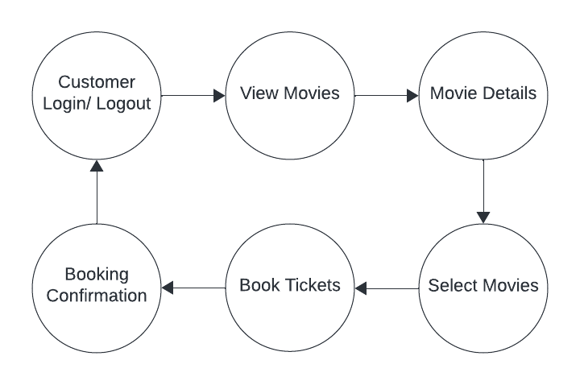
CUSTOMER
WORKFLOW

Slide 7
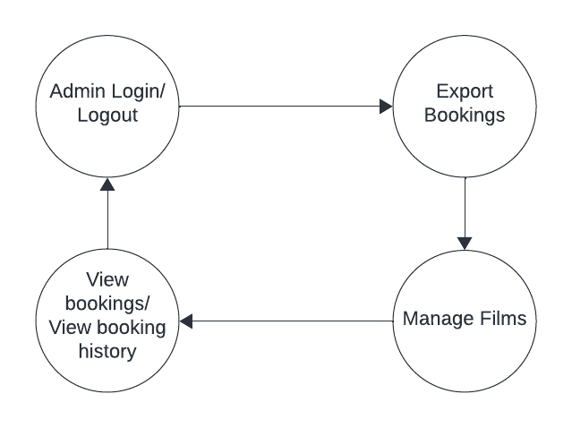
ADMIN WORKFLOW

Slide 8
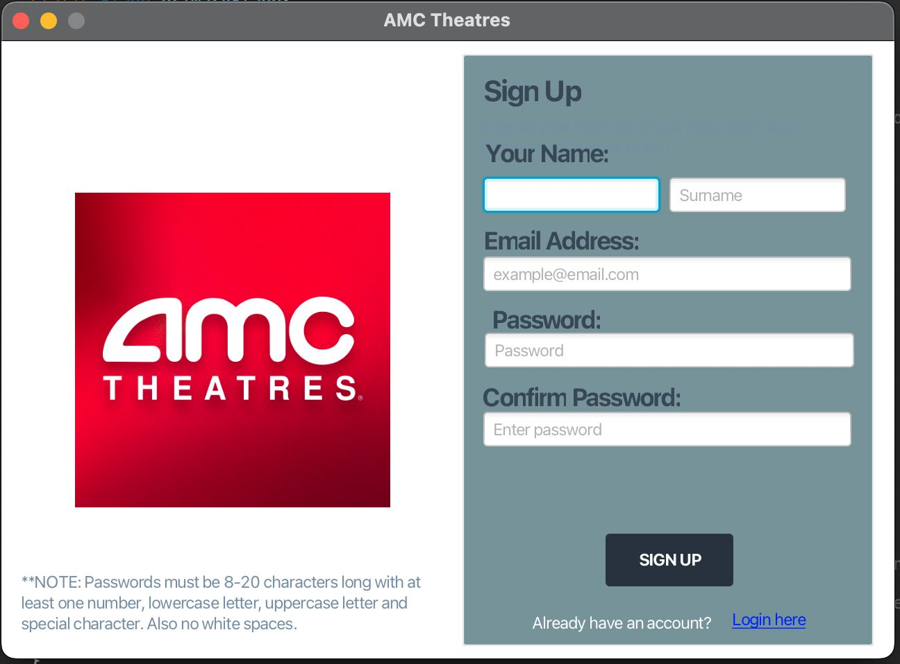
DESIGN SNAPSHOTS
This is our cinema booking system's sign-up page.
The client has the option to register as a new user by filling out the data.

Slide 9
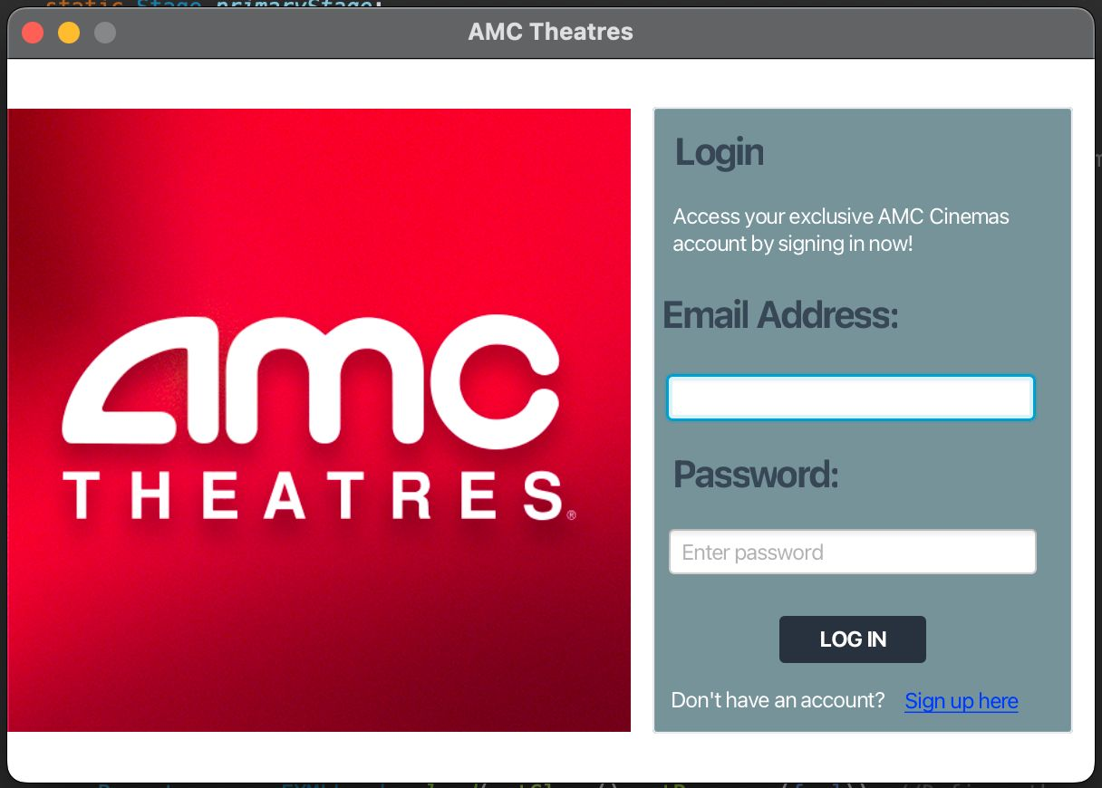
This is our cinema booking system's login page.
The customer's email address and password are required to access the system.
An error message will be shown if the password and email address do not match.

Slide 10
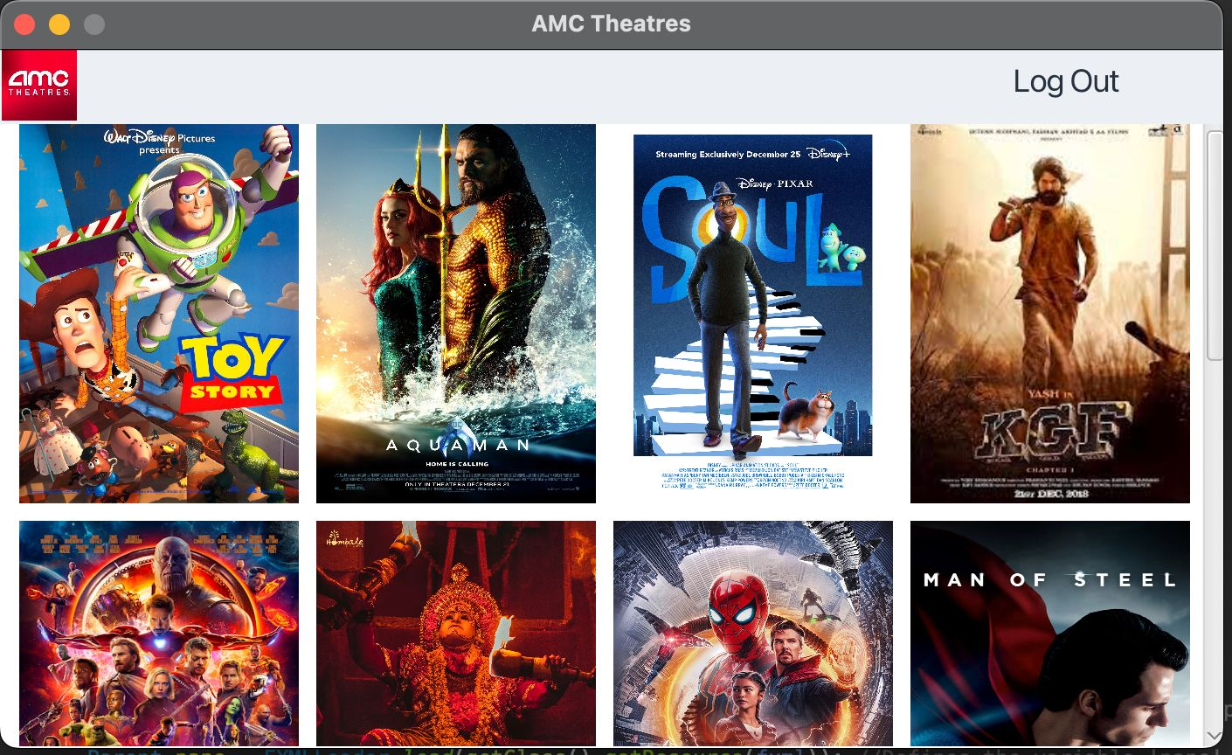
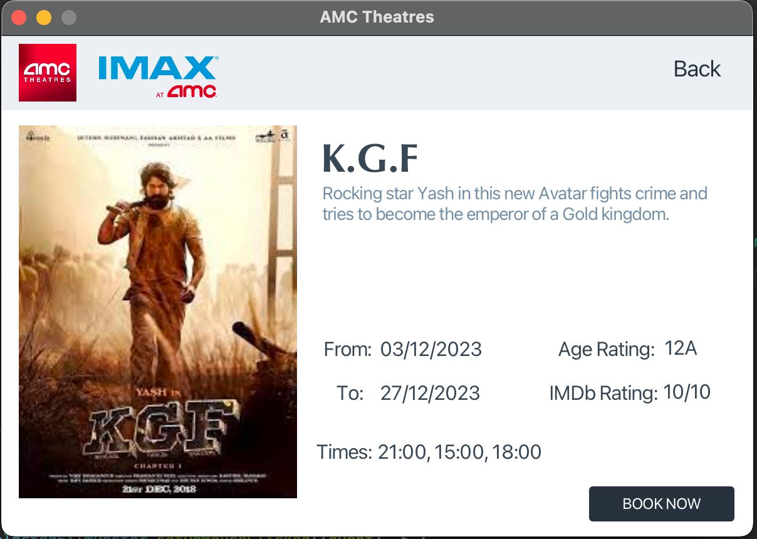
The view films page gives access to all the movies that are available to book in the theatre.
Customers may obtain information on any movie by clicking on it.
The cinema booking website may be accessed by clicking the 'Book Now' button.

Slide 11
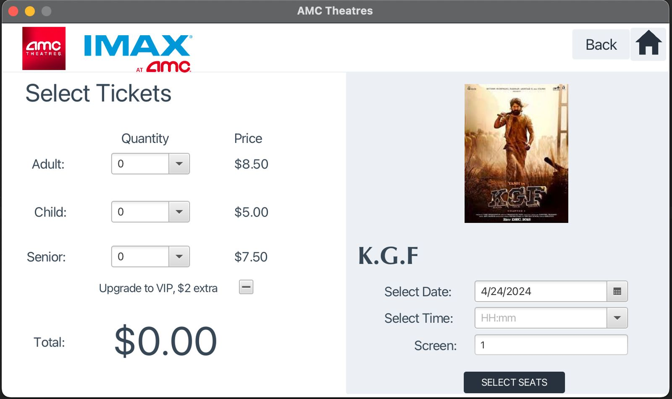
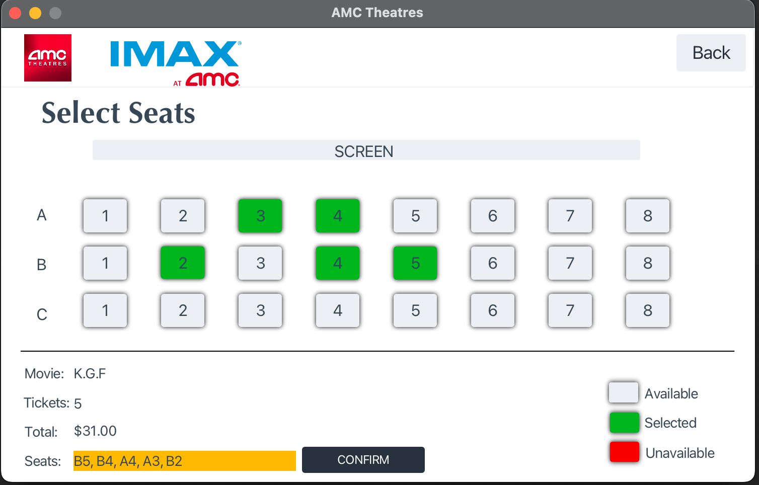
The consumer can choose the day, time, and movie to be reserved on this bookings page. The quantity of tickets to be reserved is up to the purchaser.
The user can choose their seats and verify availability after completing the form.

Slide 12
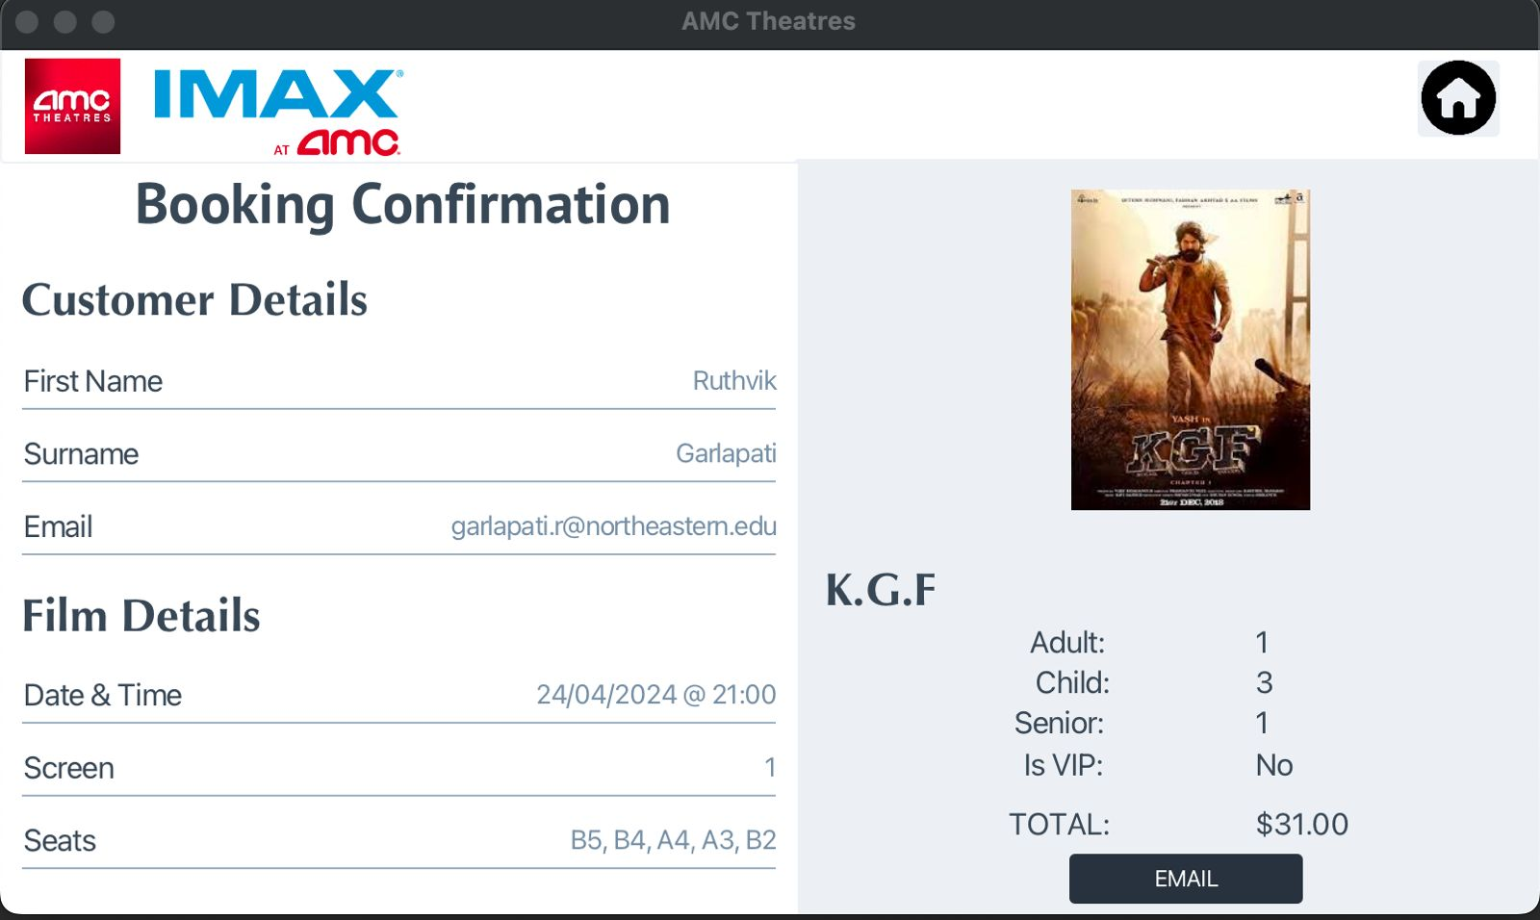
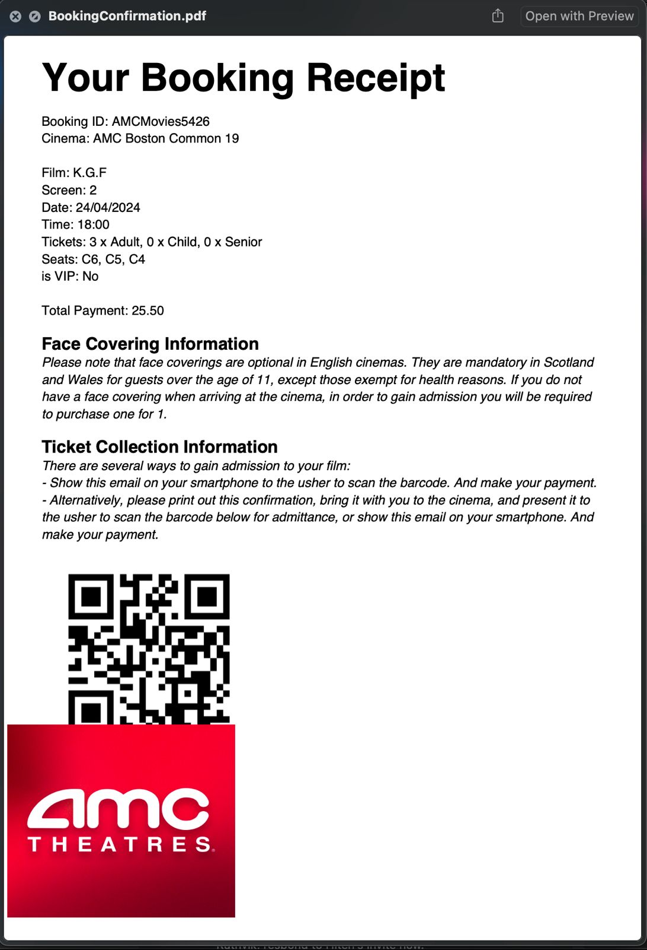
This is the page that displays the information of the booked ticket—the Booking Confirmation Page.
The email confirming the reservation is shown on the right-hand screen, and a PDF booking receipt is appended.

Slide 13
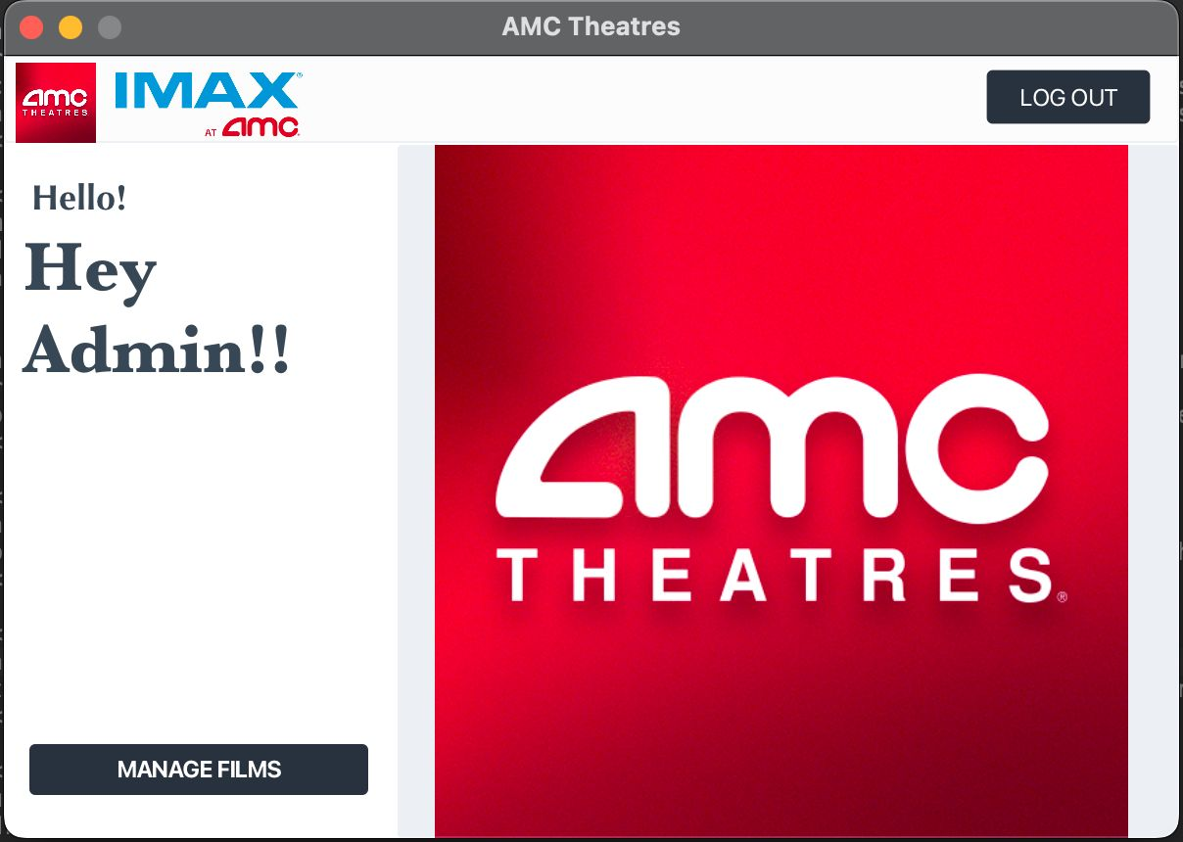
This is the admin view page, where the admin may monitor reservations, add or remove specific movies, and export bookings.

Slide 14
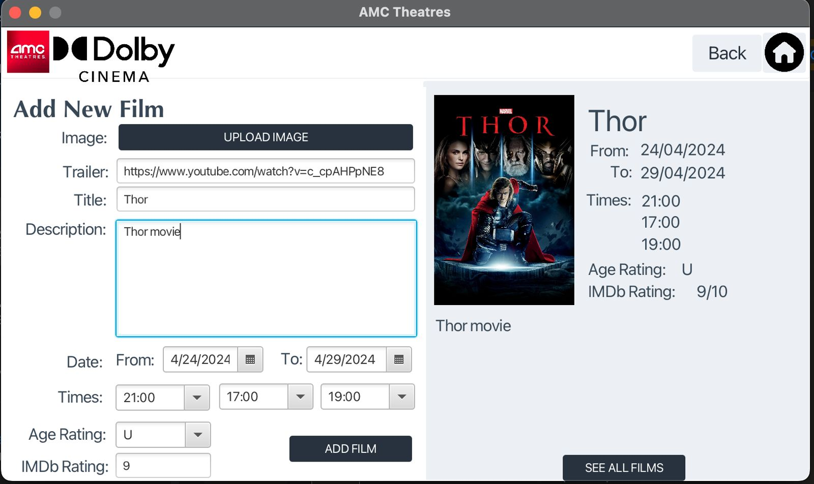
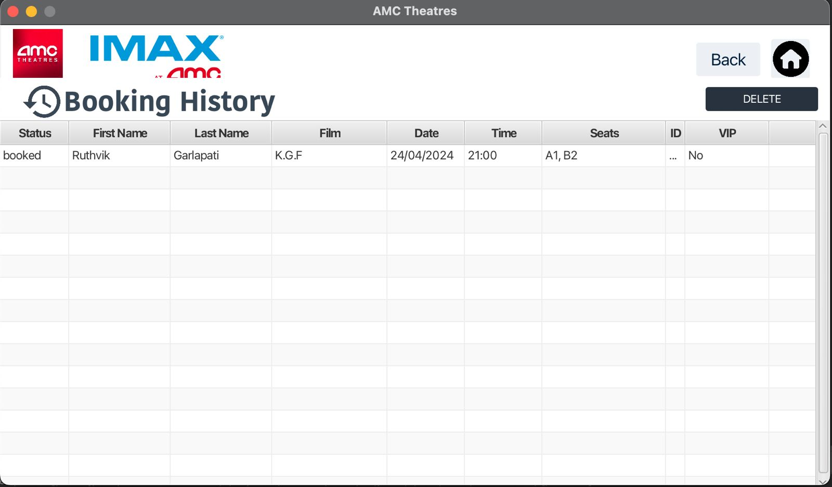
The administrator can add a new movie to the database using the choices on this page.
The administrator can add a new movie by entering its title, picture, description, date, and time.
The admin can then view the date, film, time and customer who has booked the movie.

Slide 15
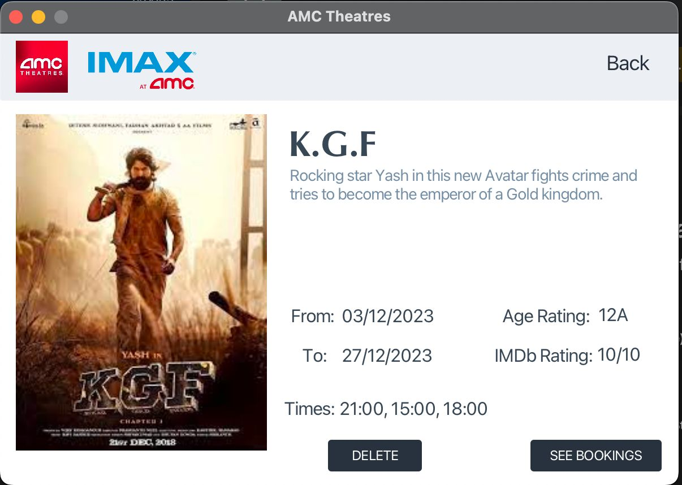
The admin can remove an existing movie from the database using the choices on this page.

Slide 16
JAVA FEATURES
The six elements that we included here are:
1. 13 Classes were defined.
2. The InvalidFilmInput Class uses inheritance from the Exception Class.
3. The resulting FXML files were worked with using the Initiliazable JavaFX interface.
4. The number of tickets, times, and validation elements were stored using an ArrayList.
5. Used HashSet to store the Booking Items history.
6. The Java Mail API for the Email feature implementation.

Slide 17
FUTURE WORK
Integration for ticket purchases with internet payment providers.
Enhanced validation and handling of errors.
In-depth movie catalogue search and filtering options.
Bookings made in the admin view are represented in seat view.
Integration with third-party APIs to retrieve movie info in real time

Slide 18
JOB ASSIGNMENT
Arpita Desai – Worked on Film Page, Film Management Page, View Films Page, design workflow and presentation
Mani Charan Reddy Loka – Worked on Main class, Login Page, SignUp Page, and presentation.
Mohitha Edara - Worked on Send Email Page, Employee Home Page, UI Design and presentation.
Ruthvik Garlapati – Worked on Ticket Booking Page, Booking Management Page, Booking HistoryItem Page and presentation
Prakhya Dasari - Worked on Confirmation Page, Seat Booking Page and presentation.

Slide 19
THANK YOU!
CSYE 6200 – Object Oriented Programming

